Slide 1
KFW ENGINEERS AND SURVEYING, INC PRESENTS
2017 MASTER DRAINAGE PLAN
FOR
THE CITY OF SHAVANO PARK

Slide 2
Table of Contents
Overview of Drainage Study Analysis
Review of Historic Documents and Previous Studies
Software Used / Methodology
GIS Database
Live Demonstration of GIS and modeling results
Drainage Study Deliverables
Review of the Drainage Areas 1-12
Description
Concern(s)
Proposed Solutions / Cost
Illustration of the Problem
Illustration of the Solution
Recommended Priority Areas
Way Ahead

Slide 3
Introduction of Study Team
This study is the culmination of the work by our dedicated and talented team at KFW. . .
Chris Otto, P.E., CFM
Sofia Reyes, E.I.T.
Claire Mai

Slide 4
Overview of Drainage Study Analysis
Overview of Drainage Study Analysis
Review of Historic Documents and Previous Studies
Software Used / Methodology
GIS Database

Slide 5
Live Demonstration of GIS

Slide 6
Drainage Study Deliverables
This study provides the following to the City of Shavano Park:
A list of storm water runoff problems with description of problem areas identified.
GIS Shapefiles for known drainage infrastructure and problem areas.
An accurate watershed map based on 2010 LiDAR data for the entire City with the 25 and 100 year storm flow rates (Q) of all watersheds in GIS mapping.
Provides ultimate solutions with proposed cost estimates.
For larger projects provide lower cost interim alternatives.
Provide a recommended list prioritizing locations based upon number of properties impacted – ensuring the City can get the best value for the City dollars

Slide 7
Study Area 1
Drainage Area 1 (DA 14)
Description. This study area focuses on the storm water runoff that accumulates in a natural basin between Wagon Trail Road and Huntington
Problem(s)
During a 25-Year storm event our model shows the basin overflowing and impact nearby properties and those properties’ homes.
Proposed Solution(s) and their cost
Our solution is to install a minimum 2300 gpm pump with 750’ of 12” discharge pipe to remove water over a 24 hour period after a storm event.
Estimated cost: $25k - $50k

Slide 8
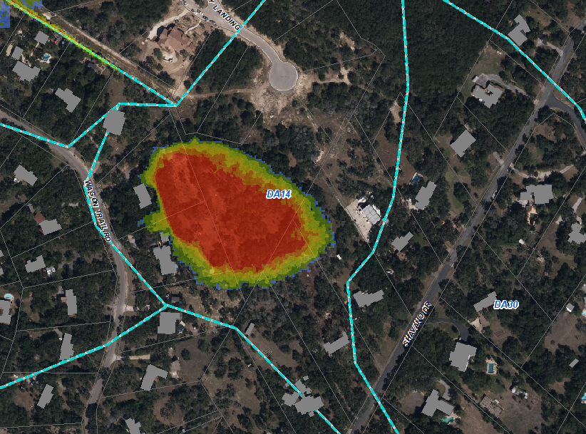
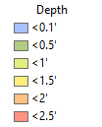
Study Area 1: The Problem
This shows the impact of a 25-year flood event.

Slide 9
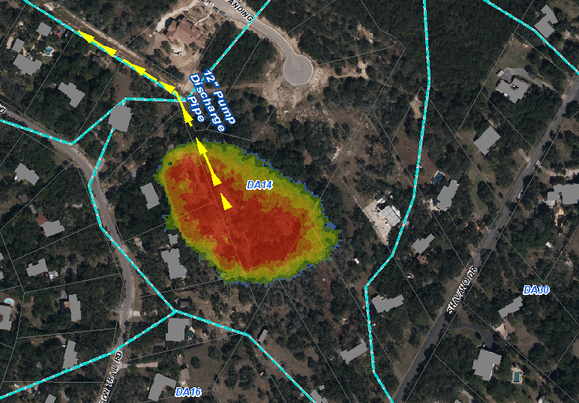
Study Area 1: The Solution
This shows the approximate location of the proposed pump and discharge pipe.

Slide 10
Study Area 2
Drainage Area 2 (DA6 & DA 8)
Description. This study area focuses on the open channel that drains from Kinnan Way to NW Military near Collins Circle.
Problem(s)
The existing channel spills the left channel bank and overflows through residential lots to Wagon Trail.
Existing TxDOT culvert causes backwater onto residential lot (16420 NW Military)
Proposed Solution(s) and their cost
Construct a small berm approximately 200’ long to prevent spill from occurring. Estimated cost $5k
Replace culvert at a lower elevation to reduce backwater elevation Estimated cost $115k

Slide 11
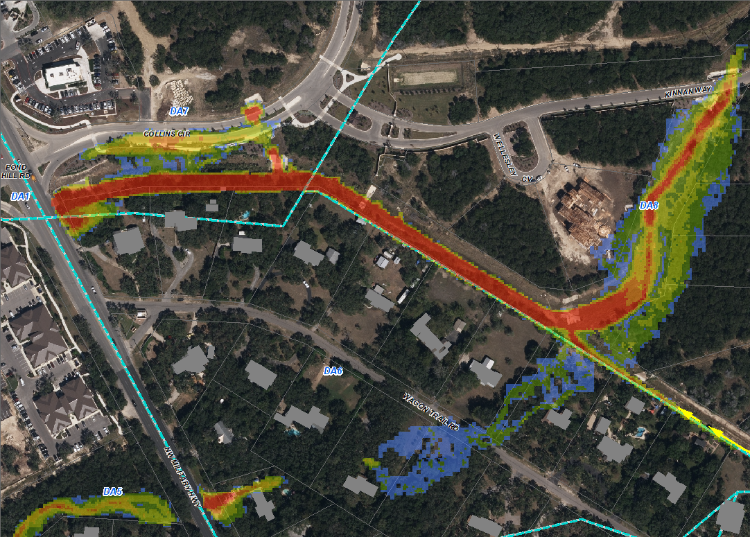
Study Area 2: The Problem
This shows the impact of a 25-year flood event.
Use your program to take pictures that will be inserted

Slide 12
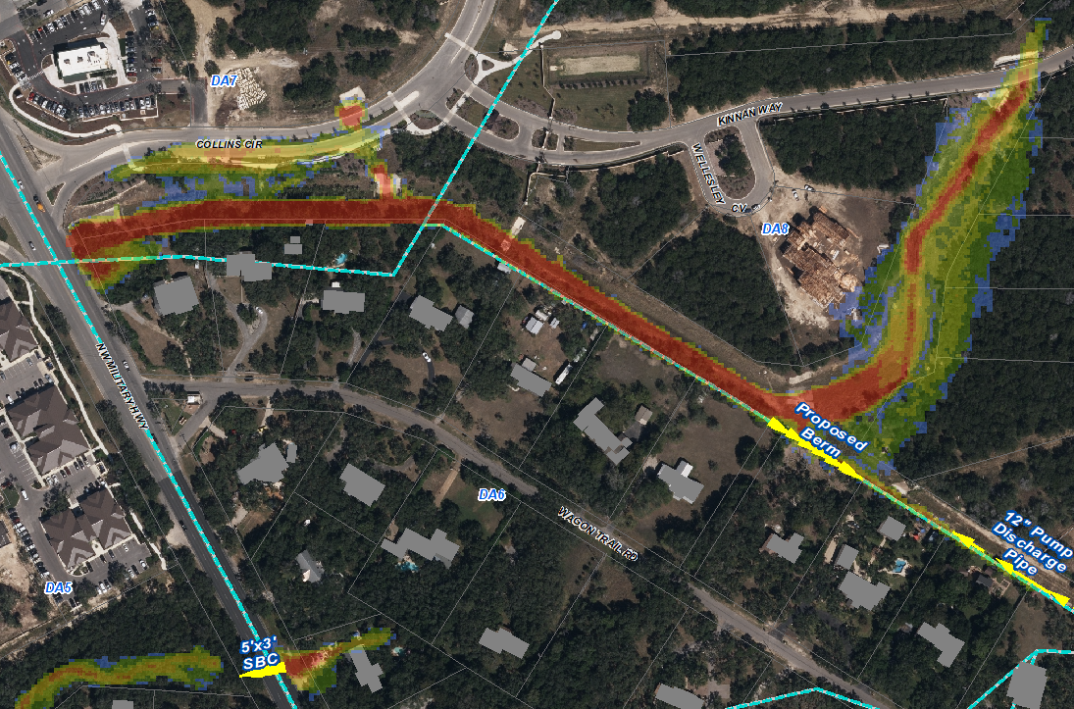
Study Area 2: The Solution
This shows the approximate location of the proposed 5’x3’ SBC,
City requested TxDOT improvements.
Proposed Berm
Use your program to take pictures that will be inserted

Slide 13
Study Area 3
Drainage Area 3 (DA 12, DA 13, DA 15 and DA 16)
Description. This study area focuses on the natural low in the Turkey Creek area.
Problem(s)
The natural low cannot contain the design storm event, impacting homes. TxDOT culvert create backwater.
Proposed Solution(s) and their cost
Construct a storm sewer system through the neighborhood Estimated cost $4.5 million
Minimum recommended: Construct culvert crossings at Honey Bee Lane, Turkey Creek Rd, and Long Bow Rd. Estimated cost $140k each
Improvements on NW Military should be constructed as part of the TxDOT project to accommodate the future project.

Slide 14
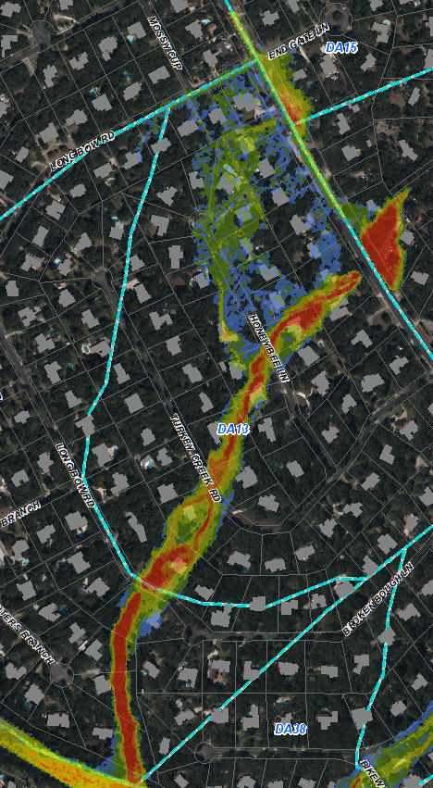
Study Area 3: The Problem
This shows the impact of a 25-year flood event.

Slide 15
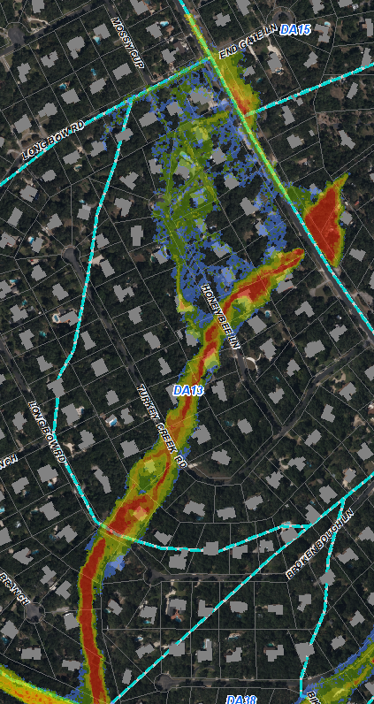
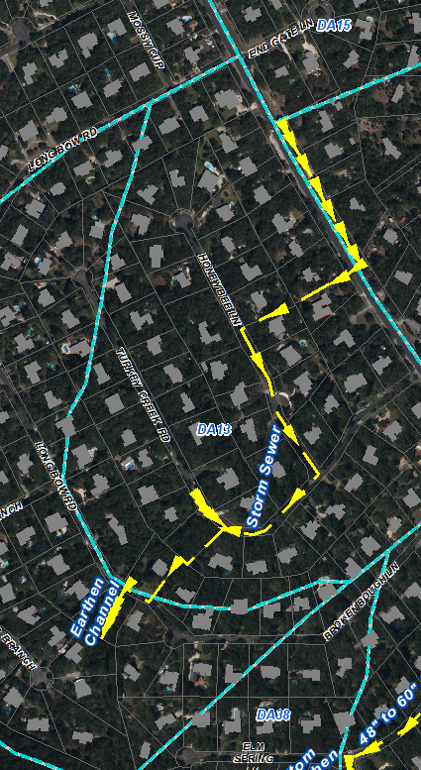
Study Area 3: The Solution
Minimum Recommended
City requested TxDOT improvements.
Minimum Recommended culvert locations.
Approximate alignment of the proposed storm sewer system.

Slide 16
Study Area 4-1
Drainage Area 4-1 (DA 19, 37, and 38)
Description. This drainage area is the storm water flows south-west from NW Military and impacts properties on Elm Spring Lane.
Problem(s)
During a 25-Year storm event our model shows flooding impacting 11 number of homes on Elm Spring.
TxDOT culverts create backwater impacting homes.
Proposed Solution(s) and their cost
Our solution is have TxDOT modify the existing culvert crossing and install a grate inlet with storm sewer system at the corner of Elm Spring and Bikeway. Estimated cost: $1.2M
We also considered a possible detention pond on City property near the Bexar 911 property, but our model shows this solution does not significantly reducing flooding on Elm Spring during a 25-year event.
Minimal recommended: Construct culvert crossing and outfall at Bikeway Lane Estimated Cost $115K

Slide 17
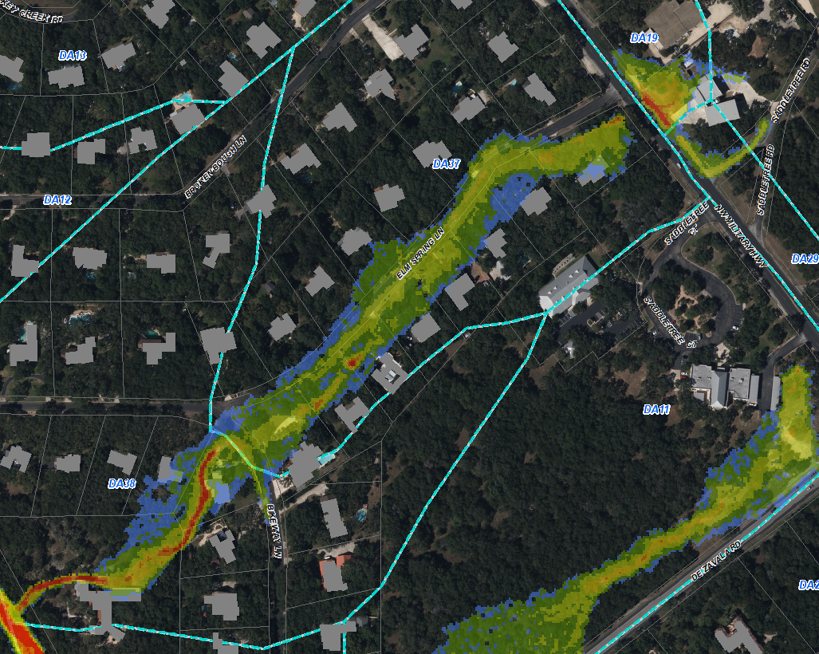
Study Area 4-1: The Problem
This shows the impact of a 25-year flood event.

Slide 18
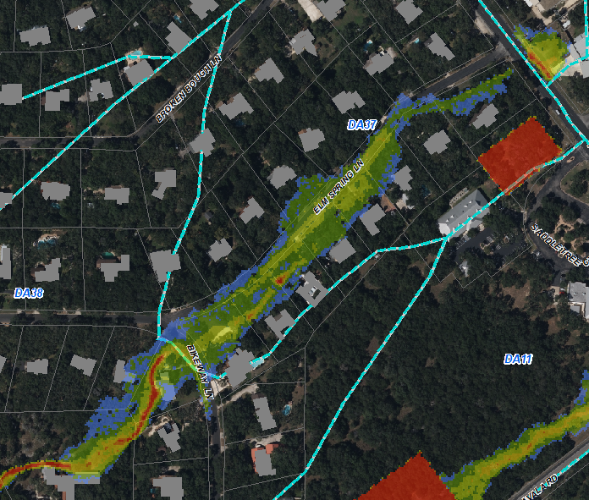
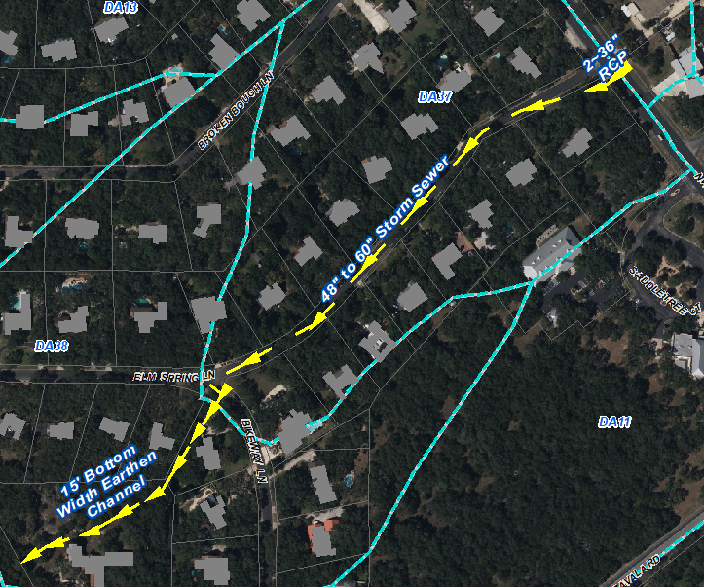
Study Area 4: The Solution
This shows the impact of a 25-year flood event after the implementation of the proposed storm sewer system.
City requested TxDOT improvements.
Minimum Recommended.
Detention Option
Storm Sewer Option

Slide 19
Study Area 4-2
Drainage Area 4-2 (DA 11, DA 20, and DA 29)
Description. This drainage area flows across the Municipal Tract across De Zavala Road to Ripple Creek Road.
Problem(s)
The 25-year design storm impact multiple homes and causes Ripple Creek Road to become impassible.
Proposed Solution(s) and their cost
Construct detention pond on the Municipal Tract, an earthen channel along the rear property lines, and a culvert at Ripple Creek Road. Estimated cost $600k
Minimum recommendation: Build detention pond and Ripple Creek culvert. Estimated cost $400k

Slide 20
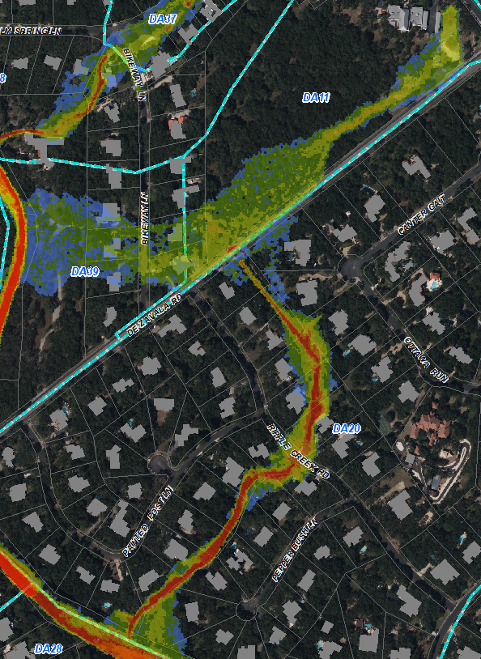
Study Area 4-2: The Problem
This shows the impact of a 25-year flood event.

Slide 21
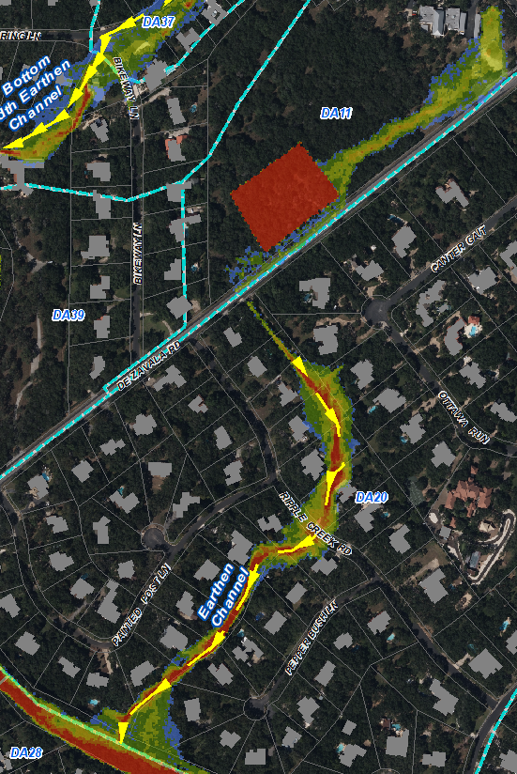
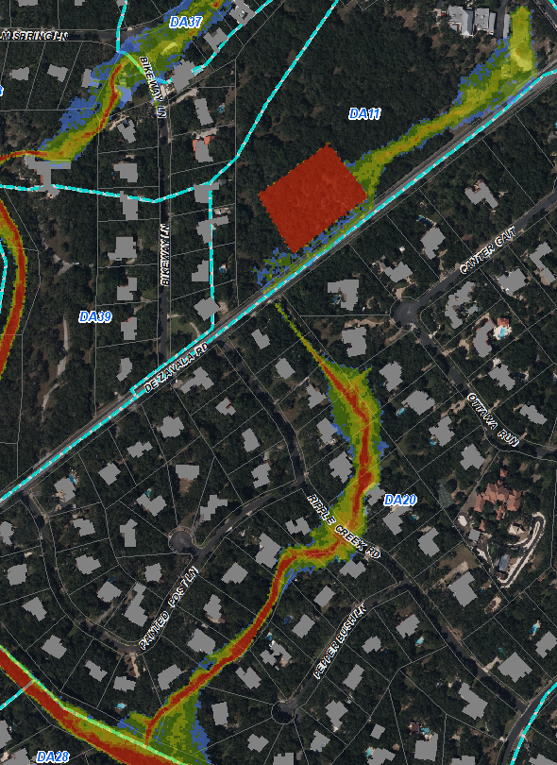
Study Area 4-2: The Solution
This shows the approximate alignment of the proposed earthen channel.
This shows the impact of a adding a detention pond on the Municipal Tract.

Slide 22
Study Area 5
Drainage Area 5 (DA 18, DA 22, and DA 23)
Description. The natural low running from Windmill Road to Bent Oak Drive and Cliffside Drive.
Problem(s)
The crossing at Windmill Road, Bent Oak, Cliffside Drive and NW Military are non-existent or undersized.
Proposed Solution(s) and their cost
Windmill Road install 3~5’x4’ MBC. Estimated cost $105k
Bent Oak Drive install 4~5’x5’ MBC. Estimated cost $130k
Cliffside Drive Upgrade existing 48” RCP to 5~6’x5’ MBC. Estimated cost $170k
NW Military upgrade existing 8’x7’ SBC to 3~8’x7’ MBC Estimated cost $200k (culvert only)
Clearing of underbrush and debris recommended to prevent clogging of downstream infrastructure. Localized reduction to water surface minimal. Estimated cost $15k

Slide 23
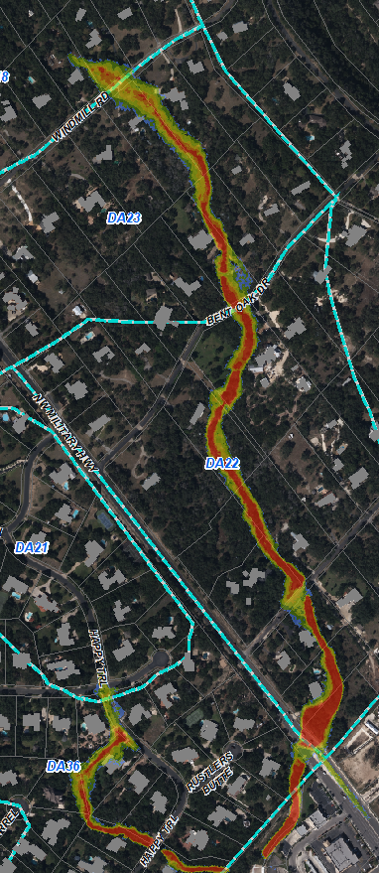
Study Area 5: The Problem
This shows the impact of a 25-year flood event.

Slide 24
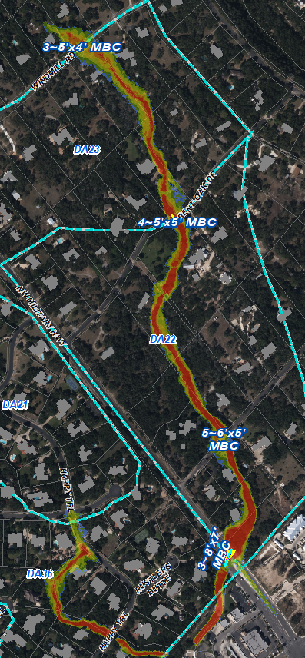
Study Area 5: The Solution
This shows the approximate locations on the proposed culvert crossings.
City requested TxDOT improvements.
Minimum Recommended.
Underbrush and debris removal.
Use your program to take pictures that will be inserted

Slide 25
Study Area 6
Drainage Area 6 (DA 21 and DA 36)
Description. This area is the natural low along Happy Trail.
Problem(s)
The existing street and channel do not have capacity for the design storm event, impacting homes.
Proposed Solution(s) and their cost
Construct storm sewer in street and 300’ earthen channel between homes on Happy Trail Estimated cost $150k
Minimum recommendation: Construct 300’ earthen channel between homes. Estimated cost $60k

Slide 26
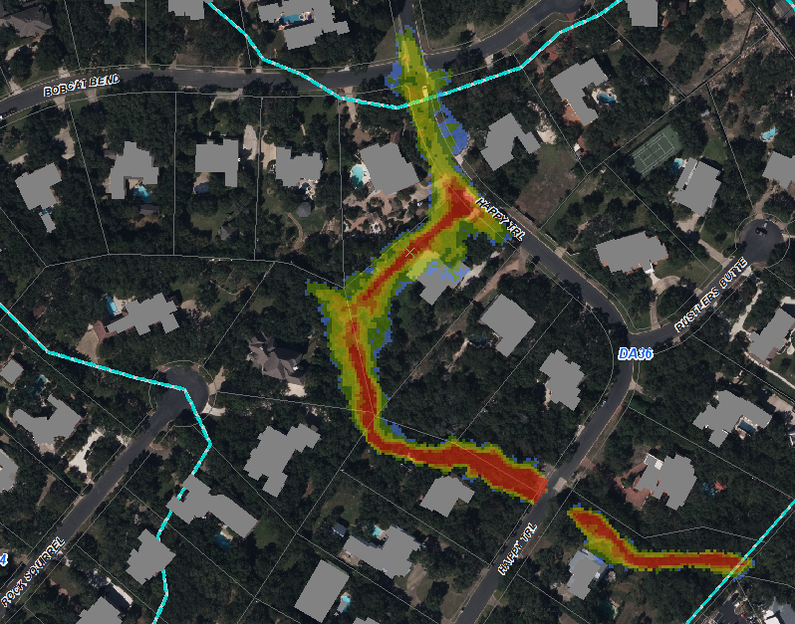
Study Area 6: The Problem
This shows the impact of a 25-year flood event.
Use your program to take pictures that will be inserted

Slide 27
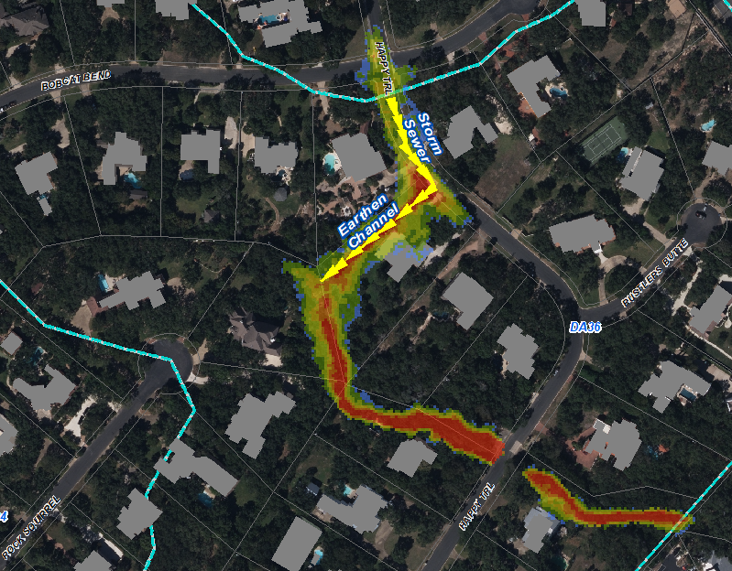
Study Area 6: The Solution
This shows the approximate locations of storm sewer and earthen channel.
Minimum Recommended.
Use your program to take pictures that will be inserted

Slide 28
Study Area 7
Drainage Area 7 (DA 26 and DA 34)
Description. Two natural lows on Happy Trail near Bobcat Bend and Rock Squirrel.
Problem(s)
The existing natural low does not have capacity, impacting homes.
Proposed Solution(s) and their cost
Bobcat Bend – construct 250’ of earthen channel between homes Estimated cost - $25k
Rock Squirrel – construct 300’ of earthen channel between homes Estimated cost – $36k

Slide 29
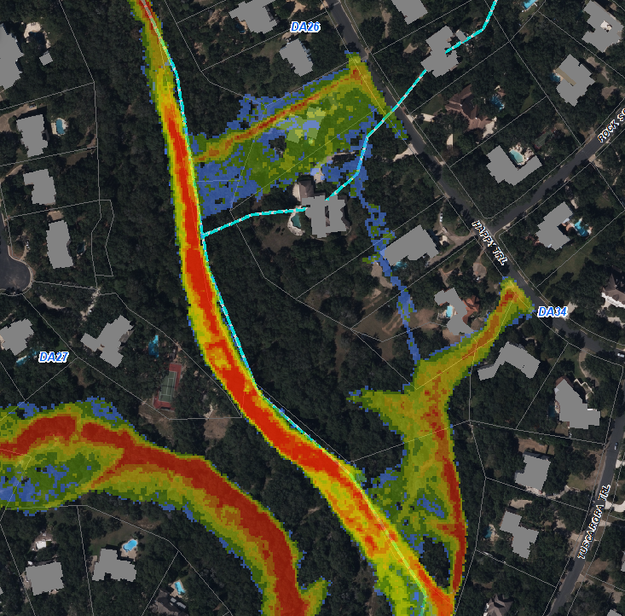
Study Area 7: The Problem
This shows the impact of a 25-year flood event.
Use your program to take pictures that will be inserted

Slide 30
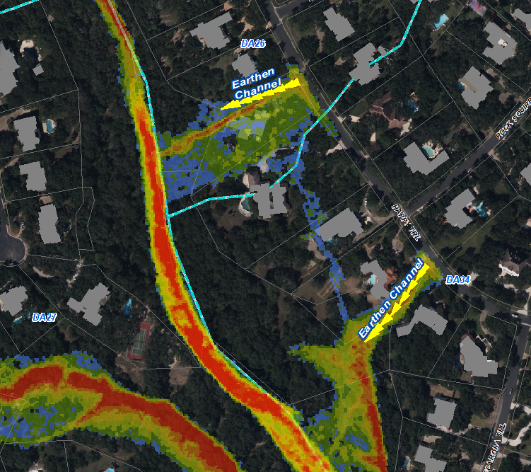
Study Area 7: The Solution
This shows the approximate location of the proposed earthen channels.
Use your program to take pictures that will be inserted

Slide 31
Study Area 8
Drainage Area 8 (DA 27, DA 28, DA 33 and DA 35)
Description. Natural low south of Cinnamon Creek and Post Oak Way
Problem(s)
Model indicates the existing culvert crossings on Blackjack Oak and Post Oak Way do not have adequate capacity. City staff indicated this is not a known problem area.
Proposed Solution(s) and their cost
Additional analysis warranted. Empirical data suggest the model may be over conservative. Estimated cost $0

Slide 32
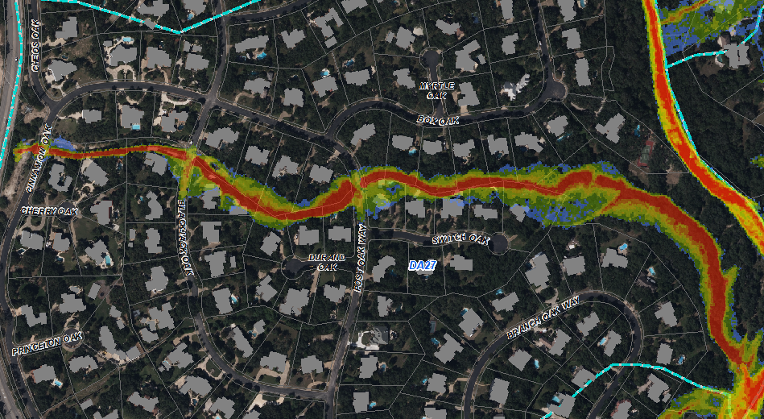
Study Area 8: The Problem
This shows the impact of a 25-year flood event.
Use your program to take pictures that will be inserted

Slide 33
Study Area 9 / 10
Study Area 9 (DA 9, DA 10 and DA 25)
Description. Bentley Manor area.
Problem(s)
No problems identified.
Study Area 10 (DA 2, DA 3 and DA 4)
Description. Shavano Commons area.
Problem(s)
No problems identified.

Slide 34
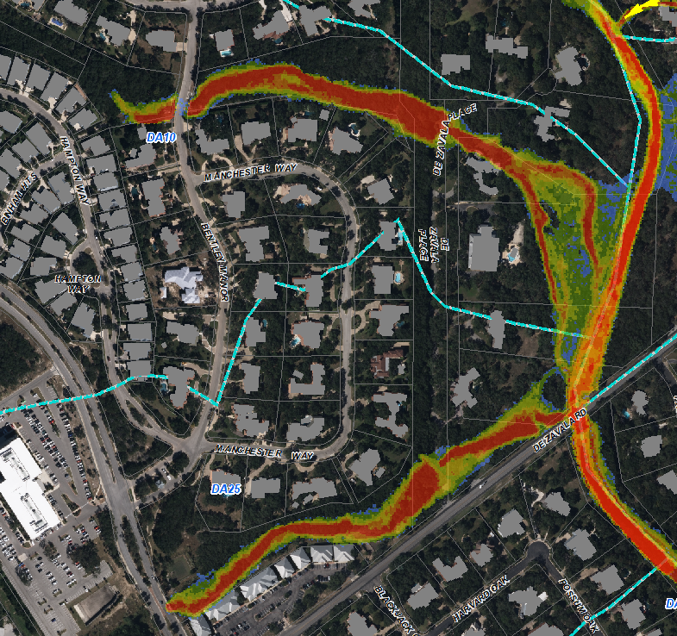
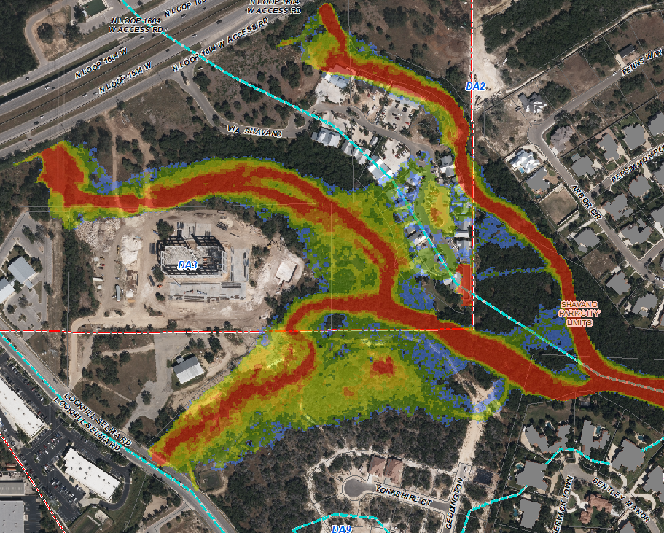
Study Area 9 / 10
Area 9
Area 10
Use your program to take pictures that will be inserted

Slide 35
Study Area 12
Drainage Area 12 (DA 17, DA 30 and DA 32)
Description. Fawn Drive and Chimney Rock Lane
Problem(s)
Road becomes impassible due to lack of culverts
Proposed Solution(s) and their cost
Fawn Drive construct a 7’x4’ SBC Estimated cost $75k
Chimney Rock Lane construct a 10’x6’ SBC Estimated cost $95k

Slide 36
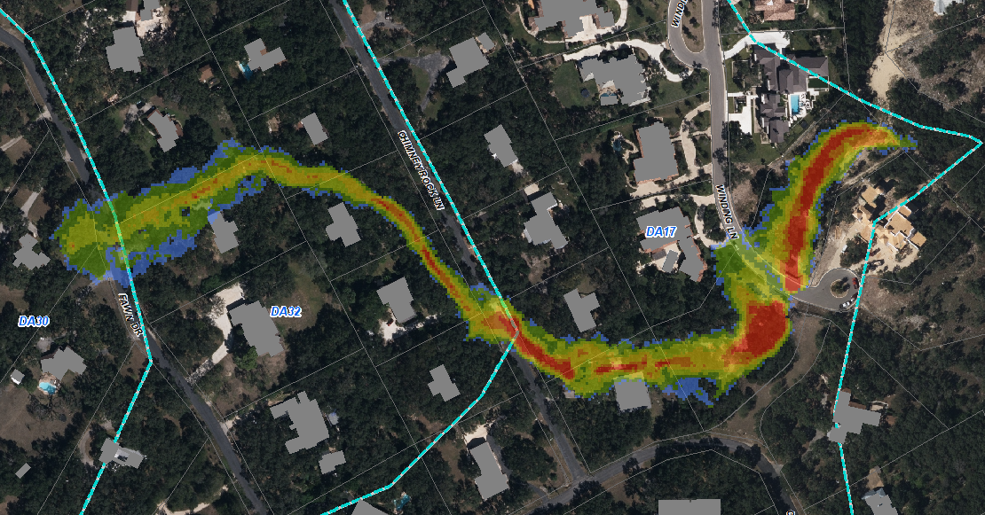
Study Area 12: The Problem
This shows the impact of a 25-year flood event.
Use your program to take pictures that will be inserted

Slide 37
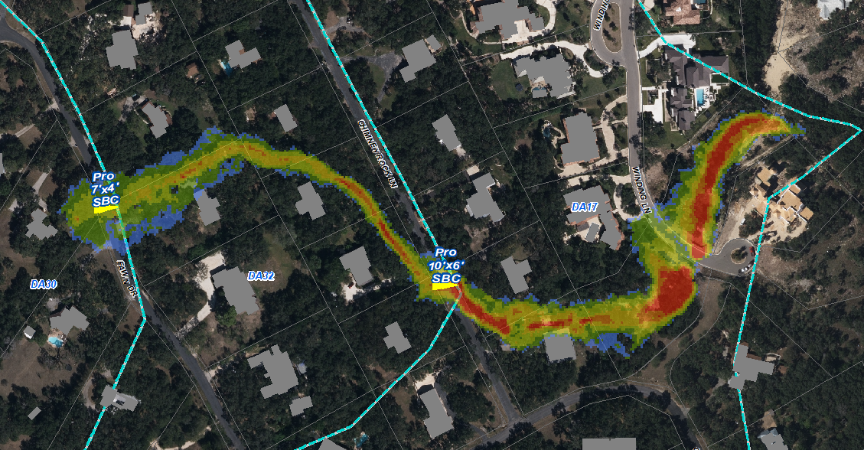
Drainage Area 12: The Solution
This shows the approximate location of the proposed culverts.
Use your program to take pictures that will be inserted

Slide 38
Preliminary Priority Areas
Criteria: Prioritized locations based upon number of properties impacted and the cost of the project – ensuring the City can get the best value for the City dollars
Area 2-1 Kinnan Way Channel Berm $5K
Area 5-5 Bent Oak Clearing $15k
Area 4-1 Elm Spring Area $1.2 million (TxDOT*)
Area 3 Turkey Creek Area $4.5 million (TxDOT*)
Area 2-2 NW Military Culvert #1 $115k (TxDOT)
Area 5-1 NW Military LWC #2 $170k (TxDOT)
Area 4-2 Ripple Creek Area $600k
Area 5-2 Cliffside LWC $170k
Area 5-3 Bent Oak LWC $130k
Area 5-4 Windmill LWC $105k
Area 12-1 Chimney Rock LWC $95k
Area 12-2 Fawn Drive LWC $75k
Area 6 Happy Trail $150k
Area 7-1 Bobcat Bend $25k
Area 7-1 Rock Squirrel $36k
Area 1 Wagon Trail Depression $25k to $50k (Developer)
*Possible Partial TxDOT participation through NW Military Operational Improvements

Slide 39
The Way Ahead
On-site interview / verification (as needed)
Staff / Public Input
Refinement of Priority Areas
Development of KFW final report
A Public Hearing and further discussion on the Drainage Study is scheduled for Planning and Zoning Commission meeting on October 11, 2017
Presentation to City Council
Note: City staff will package the drainage report in an online survey to get resident feedback on the identified problem areas and KFW’s proposed solutions.

